Slide 1

Muscle App Project
3D reconstruction of anthropometric data from various body parts
Changhun Kim
Alisha Mund
Kirolos Azer
Alankar Uniyal
Prof. Alessandro Del Vechhio
Raul C. Sîmpetru
N-squared Lab

Slide 2
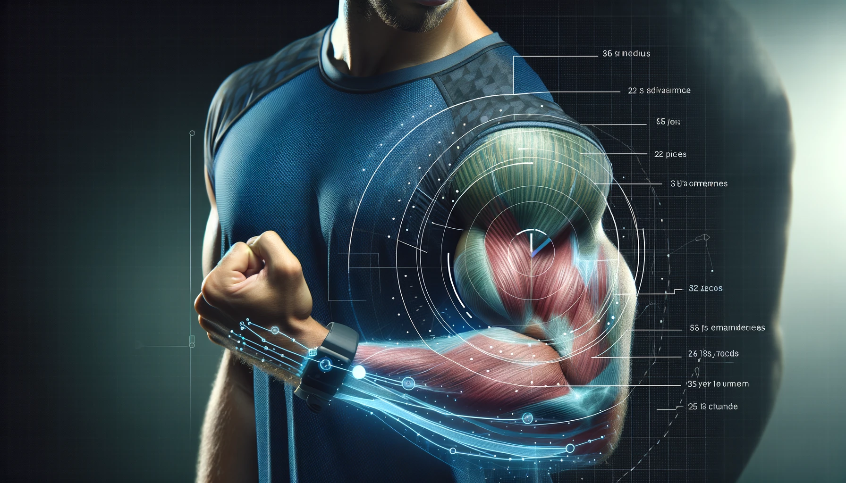
Vision
Imagine a scenario where you take a picture and overlay a mesh on it.
The user can see changes, compare the real image with the tracked one, and observe muscle growth.
This ability to measure changes like circumference or diameter is crucial for sports athletes.
The current state of the bicep and a semi-transparent layer representing the past state. This overlay allows for a direct comparison of the muscle's past and present size and shape, highlighting the changes in muscle growth. The image includes visual indicators to emphasize the differences in muscle circumference and diameter.

Slide 3
Agenda
01
Vision
02
Holistic Development of the MuscleAPP : 4 sides
03
The thoughtful consideration we‘ve given to simple ways...
04
Deep Learning approach for 3D Volumetric Mapping
05
The measurement of object dimensions (like diameter) reconstructed from volumetric mapping techniques

Slide 4
Holistic Development of the MuscleAPP
4 Sides : Application(UI-UX) , Deep Learning, NeuroScience, Business
Application and UI-UX Side
User Experience Design: Focus on creating an intuitive interface that allows users to easily upload and analyze images. The overlay mesh should be clearly visible and adjustable.
Accessibility: Ensure the app is accessible to a wide range of users, including those with different physical abilities.
Interactivity: Include features like zoom, rotate, and compare for detailed analysis of muscle growth.
Feedback Mechanism: Implement a system for users to provide feedback, ensuring continuous improvement of the app.
Cross-Platform Compatibility: Design the app to be functional on various devices and operating systems.
Deep Learning Side
3D Reconstruction(volumetric mapping): Utilize deep learning techniques like NeRF (Neural Radiance Fields) for 3D reconstruction of body parts.
Real-Time Processing: Investigate the use of voxel hashing for real-time 3D reconstruction at scale.
Data Collection: Develop methods to collect and process data from standard and LiDAR cameras.
LiDAR Integration: For devices without LiDAR, consider selling a compatible LiDAR camera as an accessory.

Slide 5
Holistic Development of the MuscleAPP
4 Sides : Application(UI-UX), Deep Learning, NeuroScience, Business
Neuroscience Side
Muscle Growth Understanding: understand muscle growth and its implications on the app.
Brain-Muscle Connection: Explore how neural activities influence muscle growth and how this can be integrated into the app.
User Feedback Analysis: Use neuroscience principles to analyze user feedback for improving app engagement and effectiveness.
Business Side
Insurance and Legalities: Navigate the complexities of health insurance and European law to ensure reimbursement and compliance.
Market Strategy: Initially target sports applications for revenue generation, then gradually move to medical applications.
Certification Planning: Prepare for DIGA certification, which could take 3-4 years, by gathering preliminary data and starting a simple company.
Partnership with Medical Professionals: Develop relationships with doctors to market the app effectively in the medical field.

Slide 6
The thoughtful consideration we‘ve given to simple ways...

Slide 7
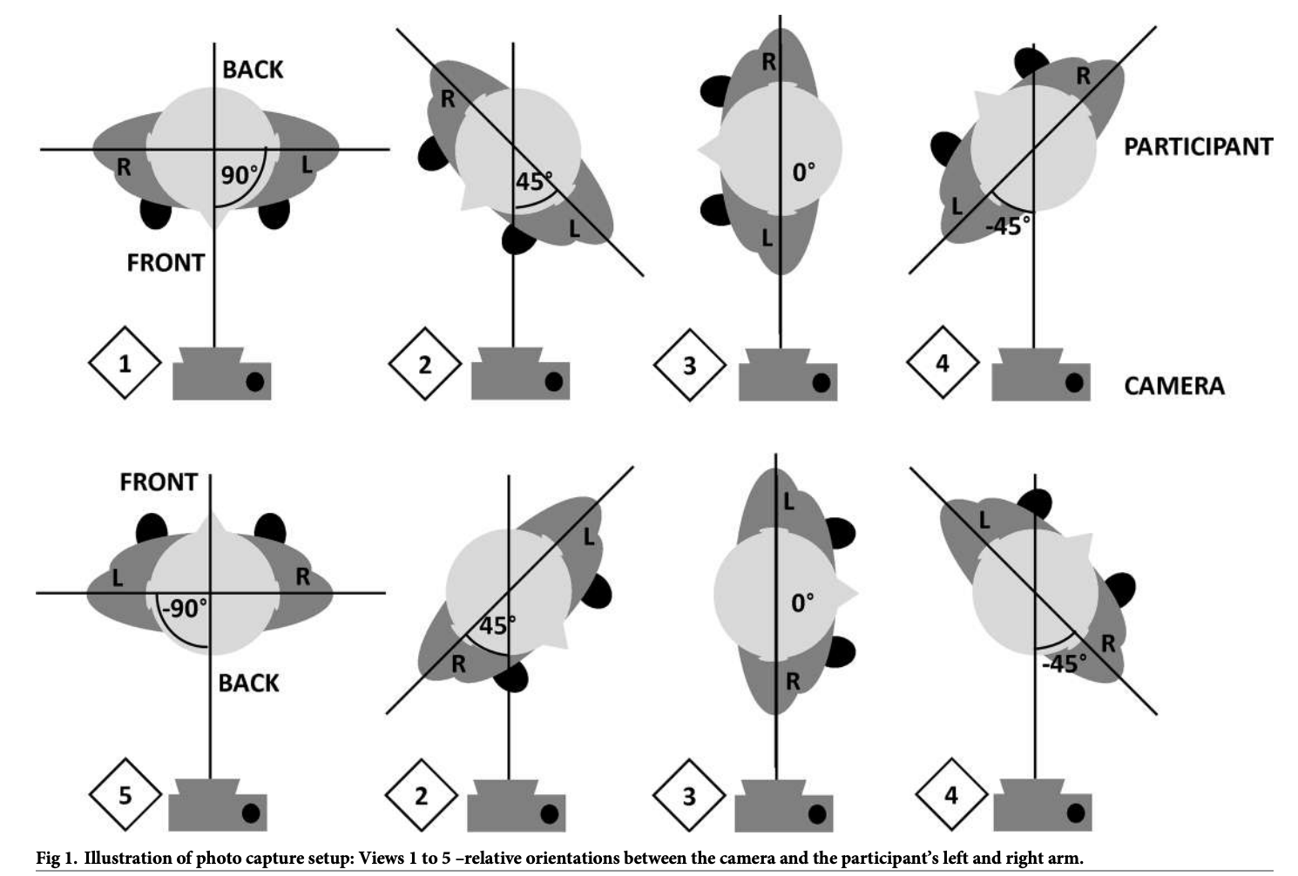
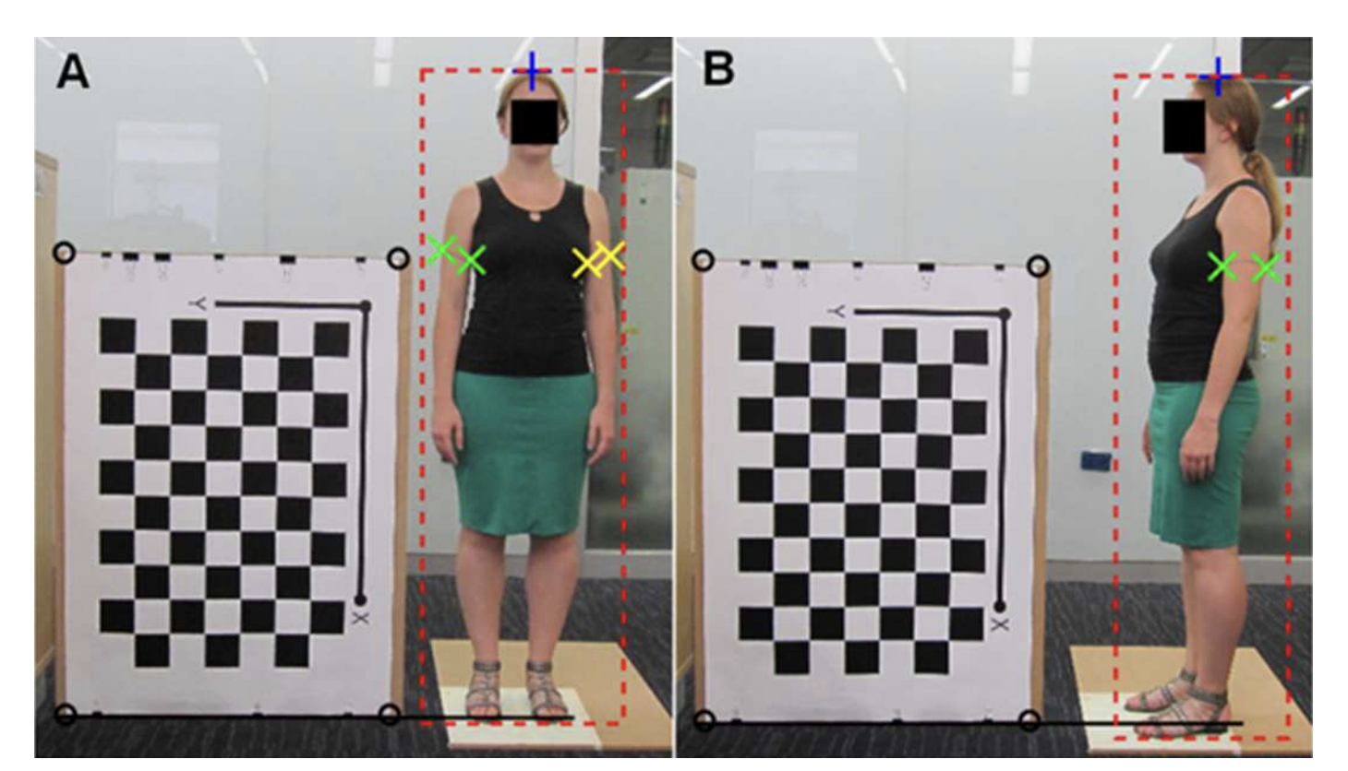
Single camera multi-view anthropometric measurement of human height and mid-upper arm circumference using linear regression
https://doi.org/10.1371/journal
Notes:
https://doi.org/10.1371/journal

Slide 8
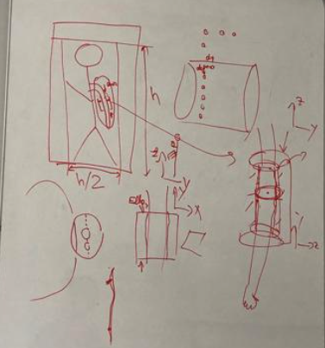
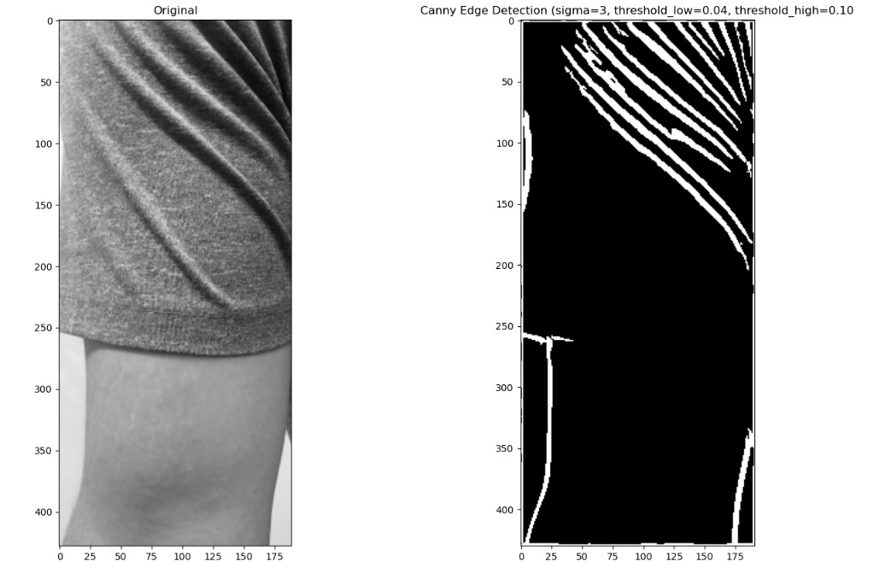
Proposed approach : Advanced Image Analysis for Muscle Growth Tracking: Multi-Angle Imaging and Edge&Object Detection Techniques
We will receive the user's height and an entire image of the user, then obtain images from multiple angles.
We will detect the target muscle part to record and trace its growth.
Using object detection methods like YOLO or simple edge detection like the Canny detector, we'll identify the target muscle part (for example, the biceps, mid-upper arm).
After completing these steps, we can determine the boundaries of the target muscle part in each image taken from different angles.
Using appropriate mathematics, we can then calculate the circumference.

Slide 9
Limitation
It is too simplistic and might not be accurate, with significant errors from this method, and we need to obtain the user's height. Additionally, it's challenging for users to take multi-angle, full-body pictures.
Assuming, completing these simple tasks might take a semester, but they might not be that useful.
Therefore, we have shifted to a 3D reconstruction method, which is more complicated but should be far more accurate.
This method can be improved gradually and could be applied in the real app to provide precise measurements.

Slide 10
Deep Learning approach for 3D Volumetric Mapping

Slide 11
Combination of 2 method(Nerf + 3D Gaussian)
measure changes in muscle size and overlay a mesh on muscle 3D shapes
NeRF (Neural Radiance Fields):
Detail and Realism: NeRF excels in creating highly detailed and photorealistic 3D models from 2D images. It can capture intricate details of muscle shape and size.
Depth and Perspective: NeRF's use of ray tracing allows for a detailed understanding of depth and perspective, which can be crucial in accurately measuring changes over time.
Limitations: While NeRF provides high-quality visualizations, the complexity of its models might make direct measurement of spatial changes more challenging.
3D Gaussian Models:
Spatial Analysis: These models are excellent for understanding spatial relationships and variations in density. They can provide a more straightforward approach to measuring changes in size and volume.
Data Representation: 3D Gaussian models represent data in a volumetric space, which can be more intuitive for quantifying changes in muscle size.
Limitations: They might not offer the same level of visual detail as NeRF and are more suited for statistical and probabilistic analysis rather than photorealistic rendering.
In practice, a combination of both approaches could be beneficial: NeRF for detailed 3D modeling and visualization, and 3D Gaussian models for direct spatial and volumetric analysis.

Slide 12
"volumetric" mapping
measure changes in muscle size and overlay a mesh on muscle 3D shapes
NeRF is indeed not a "volumetric" mapping method in the traditional sense. It's more about creating photorealistic 3D renderings from 2D images using deep learning techniques.
On the other hand, 3D Gaussian models are more aligned with volumetric analysis, focusing on the spatial distribution and probability densities of data points in three-dimensional space.
Your application's requirements seem to align more closely with the capabilities of NeRF, especially since you are interested in overlaying a mesh on a picture to observe detailed changes like muscle growth. NeRF's ability to create highly detailed and realistic 3D models from 2D images can be particularly beneficial for capturing intricate details and changes in muscle size and shape over time.
In contrast, while 3D Gaussian models could provide insights into spatial relationships and variations in density, they may not offer the same level of visual detail and precision necessary for rendering a 3D mesh over a 2D image, especially in the context of tracking physical changes like muscle growth.

Slide 13
Nerf Instant , 3D Gaussian, references
Getting Started with NVIDIA Instant NeRFs | NVIDIA Technical Blog
3D Gaussian Splatting for Real-Time Radiance Field Rendering
Existing applications that does 3D reconstruction
AI 3D reconstruction Using Iphone Camera
Unlocking The Hidden Lasers on Your Phone To Make 3D Images
Getting Started with Photogrammetry Using Your Cell Phone

Slide 14
The measurement of object dimensions (like diameter) reconstructed from volumetric mapping techniques

Slide 15
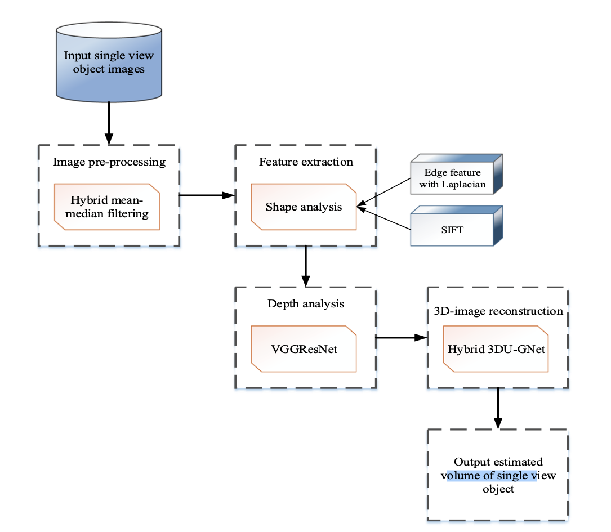
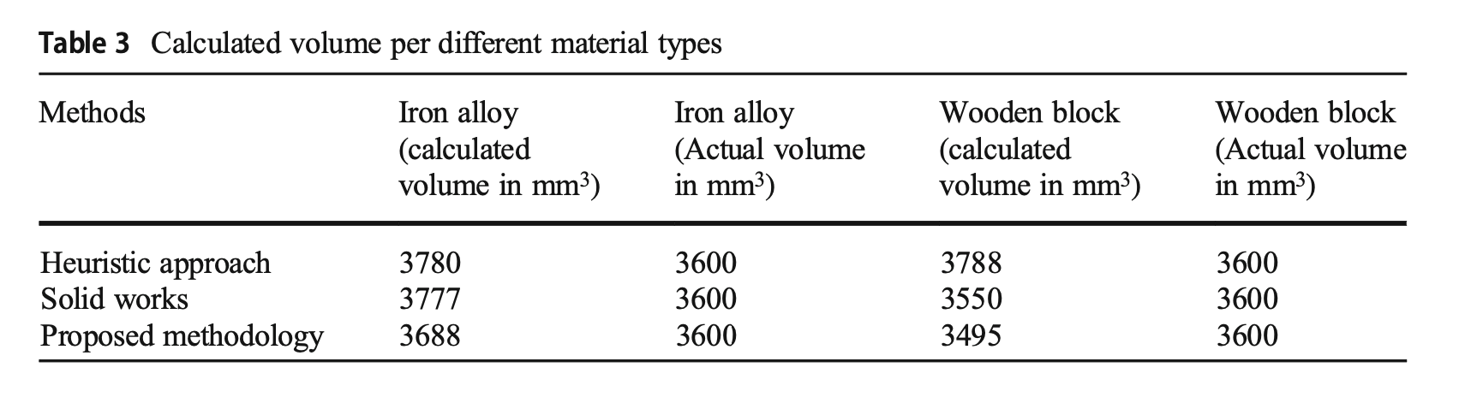
An Accurate Volume Estimation on Single View Object Images by Deep Learning Based Depth Map Analysis and 3D Reconstruction
Dalai et al.
We need depth and RGB cameras
4.1 Dataset description: NYC dataset This NYC dataset consists of a large number of images captured with both depth and RGB cameras. This dataset contains 1449 aligned depth and RGB images and 464 newest images from 3 different cities. The image present in this dataset is utilized for the volume estimation. Moreover, this dataset contains the images with single object view.
https://doi.org/10.1007/s11042-023-14615-7

Slide 16
But biceps have a more complicated shape than the wood or iron alloy used in the paper. Should we need some adaptation?
Human Anatomy Complexity: The biceps are more complex than rigid objects. Their unique shape, muscle tone, and skin texture make depth perception in images challenging, requiring advanced techniques for analyzing features and depth.
Model Adaptation: The deep learning models from the study, like VGG-ResNet and 3DU-GNet, may need updates to better understand biceps. This could involve training with a varied collection of arm images and possibly 3D scans for accuracy.
Dealing with Pose and Lighting: The arm's position and lighting can change how it looks in images, affecting volume estimates. The system should handle these variations effectively.
4. Accuracy Needs: For medical or fitness uses, high accuracy is essential. The system's accuracy and precision must meet the demands of these applications.
5. Ethics and Privacy: Using human images, especially for health, raises privacy and ethical issues. It's vital to manage this data responsibly and follow privacy laws and standards.

Slide 17
It‘s hard to obtain a set of biceps and volume pair data for training
Measuring the volume of human biceps precisely is not straightforward and typically requires specialized equipment or techniques, such as water displacement or 3D body scanning, which are not easily accessible for large-scale data collection.
However, to adapt the volume estimation method for biceps, having such a dataset would be ideal for training and fine-tuning the deep learning models. Here are a few alternative approaches you might consider:
Synthetic Data Generation: Use 3D modeling software to create a diverse range of synthetic biceps models with known volumes. These models can simulate different sizes, shapes, and poses. While synthetic data may not capture all the nuances of real-world data, it can be a useful starting point.
Semi-Supervised Learning: If collecting a large set of labeled data is challenging, semi-supervised learning techniques can be employed. In this approach, a smaller set of labeled data (biceps images with known volumes) is used alongside a larger set of unlabeled data. This can help in learning robust feature representations.
Transfer Learning: Utilize a model pre-trained on a related task (such as human body pose estimation or 3D human shape reconstruction) and fine-tune it on a smaller dataset of biceps images. Transfer learning can leverage learned features from a related domain to reduce the amount of new data required.
Data Augmentation: For the limited data that you can collect, data augmentation techniques (like image rotations, scaling, and lighting adjustments) can help in artificially expanding the dataset and improving the robustness of the model.

Slide 18
How to Assign Task?

Slide 19
Milestone & Tasks
Apply a simple method for an "implementation".
Pros: We can produce an output.
Cons: It might be plausible but not accurate or useful.
Dive into 3D volumetric technologies
Pros: This provides a solid foundation that we can build upon.
Cons: It is a complex technology that requires time to understand and adapt for our application. Just understanding the concepts and imitating them might take up this entire semester.
Alankar : Lidar camera integration
Changhun : Nerf
Alisha : 3D Gaussian
Kirolos : calculate circumference from 3D volumetric space

Slide 20
4-1. How to Gather and Prepare Data:
Data Collection: Accumulate a diverse dataset. This might include 2D images, 3D LiDAR data, and any other relevant data (like anthropometric measurements).
Data Preprocessing: Clean and preprocess your data. This could involve normalizing images, filtering LiDAR data, and labeling your data for supervised learning tasks.
Input Data?
We can have the user perform a 360-degree scan of the target muscle part and use this data for 3D reconstruction.
Integrate with LiDAR camera.

Slide 21
4-2.. Infrastructure and Tools
Development Environment: Should we use PyTorch, TensorFlow, PyTorch Lightning, or just use an Amazon or Nvidia instance?
Computational Resources: Consider GPU and TPU if we build our own model.
4-3. Model Training and Validation
Integration with Application
API Development: Integrate the deep learning model with the application’s frontend and other systems.
User Testing: Perform extensive user testing to ensure the models work well in real-world scenarios.

Slide 22
References
https://skinny-moose-664.notion.site/Application-Objective-e20df3e9f57042019b26750828c327f9?pvs=4
Getting Started with NVIDIA Instant NeRFs | NVIDIA Technical Blog
3D Gaussian Splatting for Real-Time Radiance Field Rendering
https://doi.org/10.1371/journal.pone.0195600
https://www.researchgate.net/publication/368688521_An_accurate_volume_estimation_on_single_view_object_images_by_deep_learning_based_depth_map_analysis_and_3D_reconstruction

Slide 23
Thanks for your attention

